Slide 1

Chapter 10 Planar Graphs
Section 10.1
The Euler Identity

Slide 2


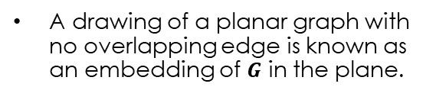
Planar and Plane Graphs
Planar Graph
Plane Graph
A graph $G$ is planar when is can be drawn on a plane with no overlapping edge
A graph $G$ is a plane graph when it is drawn on a plane with no overlapping edge
A drawing of a planar graph with no overlapping edge is known as an embedding of $G$ in the plane.
All Plane Graphs are Planar Graphs; Not all Planar Graphs are Plane Graphs

Slide 3
Planar Graphs
The edges of a plane graph G form sections of the plane referred to as regions.
One of these regions is unbounded and referred to as the exterior region.
The vertices and edges surrounding a region are referred to as the boundary of the region.
R₄
R₁
R₂
R₃

Slide 4
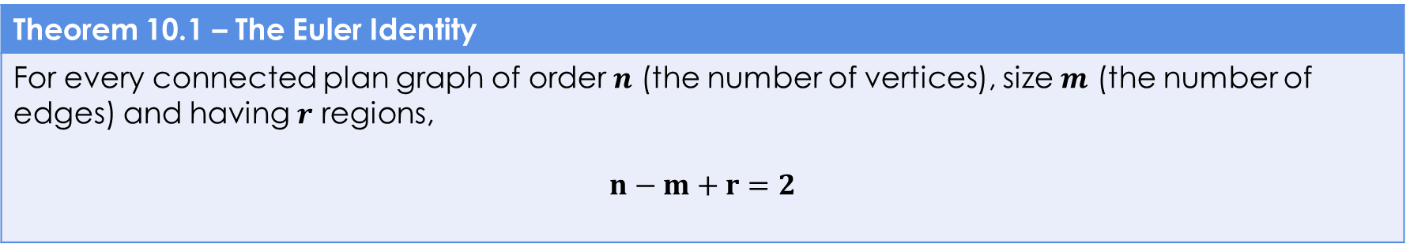
The Euler Identity
Theorem 10.1 – The Euler Identity
For every connected plan graph of order $n$ (the number of vertices), size $m$ (the number of edges) and having $r$ regions, $$n−m+r=2$$

Slide 5
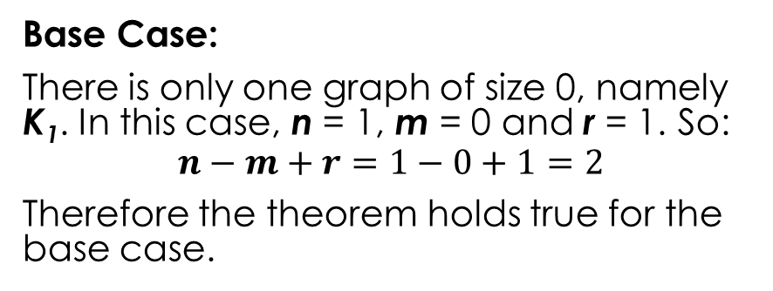
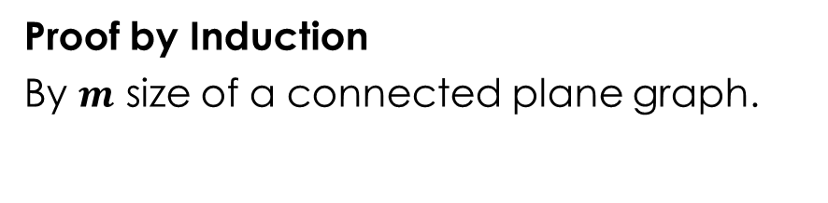

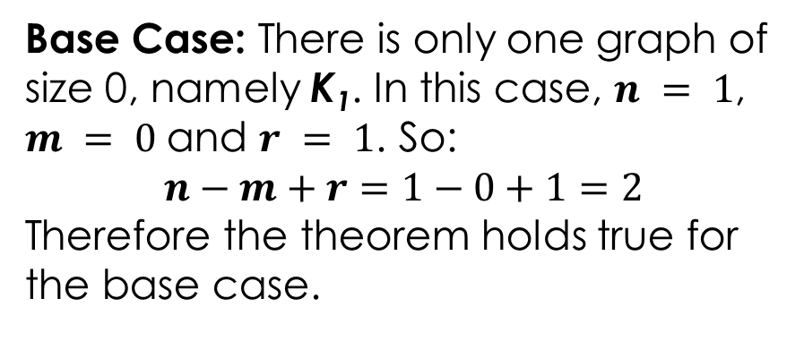
The Euler Identity - Proof
Proof by Induction
By $m$ size of a connected plane graph.
Base Case:
There is only one graph of size 0, namely K₁. In this case, n = 1, m = 0 and r = 1. So:
$$n−m+r=1−0+1=2$$
Therefore the theorem holds true for the base case.
Base Case: There is only one graph of size 0, namely K₁. In this case, $n = 1$, $m = 0$and $r = 1$. So:
$$n−m+r=1−0+1=2$$
Therefore the theorem holds true for the base case.
Let G be a connected graph of order $n$ and size $m$ with $r$ regions.
There are two cases to consider:

Slide 6
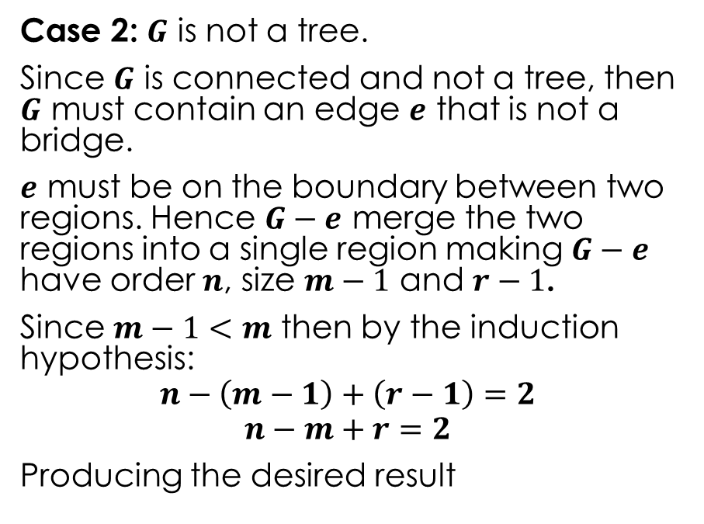

The Euler Identity – Proof (cont.)
Case 1: $G$ is a tree.
In this case $m=n−1$ and $r=1$
Then:
$$n−m+r=n−\left(n−1\right)+1=2$$
Producing the desired result.
Case 2: $G$ is not a tree.
Since $G$ is connected and not a tree, then $G$ must contain an edge $e$ that is not a bridge.
$e$ must be on the boundary between two regions. Hence $G−e$ merge the two regions into a single region making $G−e$ have order $n$, size $m−1$ and $r−1$.
Since $m−1<m$ then by the induction hypothesis:
$$n−\left(m−1\right)+\left(r−1\right)=2$$
$$n−m+r=2$$
Producing the desired result

Slide 7


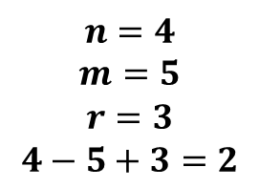
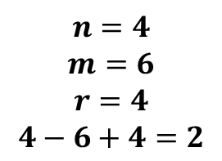

The Euler Identity – Visualization of Case 2
$$G$$
$$G−e$$
$$e$$
$$n=4$$
$$m=6$$
$$r=4$$
$$4−6+4=2$$
$$n=4$$
$$m=5$$
$$r=3$$
$$4−5+3=2$$

Slide 8
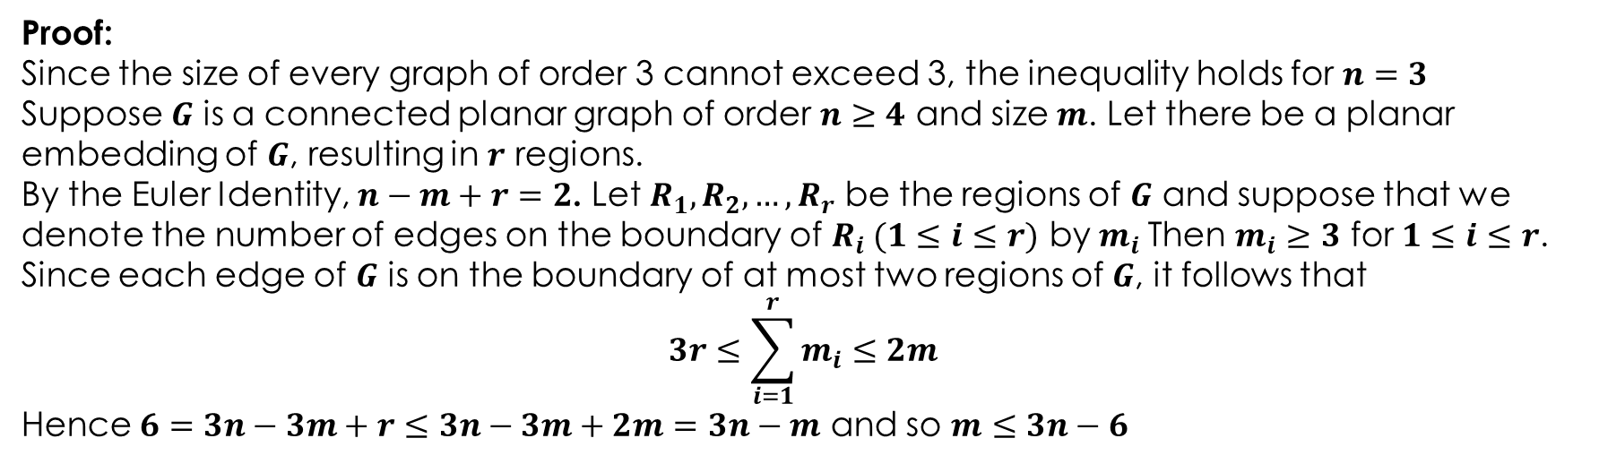
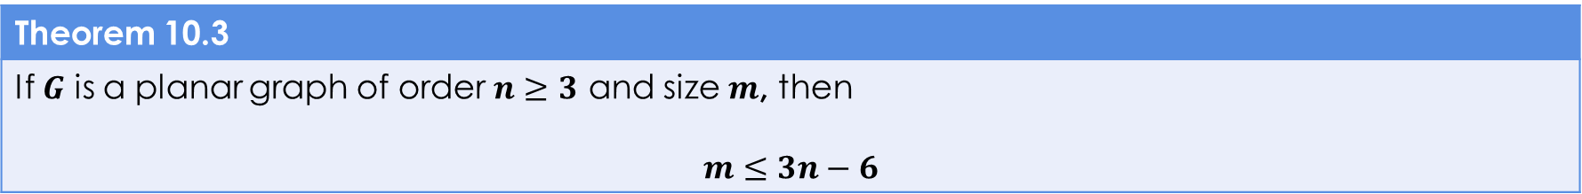
Theorem 10.3
Theorem 10.3
If $G$ is a planar graph of order $n≥3$ and size $m$, then $$m≤3n−6$$
Proof:
Since the size of every graph of order 3 cannot exceed 3, the inequality holds for $n=3$
Suppose $G$ is a connected planar graph of order $n≥4$ and size $m$. Let there be a planar embedding of $G$, resulting in $r$ regions.
By the Euler Identity, $n−m+r=2$. Let $R_{1},R_{2},…,R_{r}$ be the regions of $G$ and suppose that we denote the number of edges on the boundary of $R_{i} (1≤i≤r)$ by $m_{i}$Then $m_{i}≥3$ for $1≤i≤r$.
Since each edge of $G$ is on the boundary of at most two regions of $G$, it follows that
$$3r≤\sum_{i=1}^{r}{m_{i}}≤2m$$
Hence $6=3n−3m+r≤3n−3m+2m=3n−m$ and so $m≤3n−6$

Slide 9
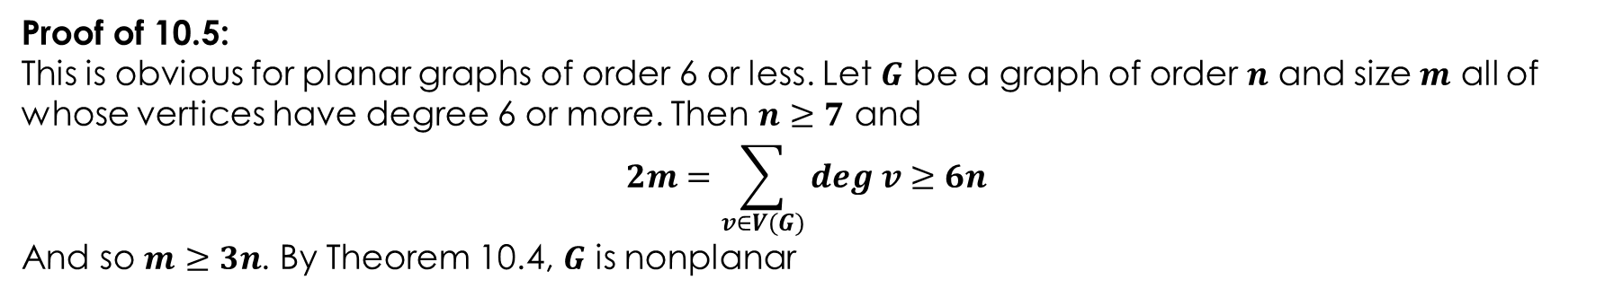
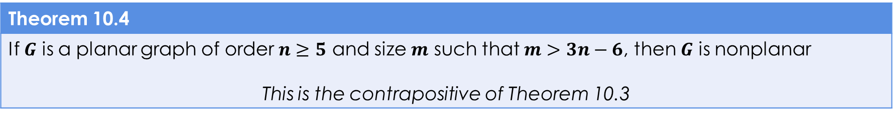
Theorem 10.4,5
Theorem 10.4
If $G$ is a planar graph of order $n≥5$ and size $m$ such that $m>3n−6$, then $G$ is nonplanar This is the contrapositive of Theorem 10.3
Corollary 10.5
Every planar graph contains a vertex of degree 5 or less
Proof of 10.5:
This is obvious for planar graphs of order 6 or less. Let $G$ be a graph of order $n$ and size $m$ all of whose vertices have degree 6 or more. Then $n≥7$ and
$$2m=\sum_{v∈V(G)}{deg v}≥6n$$
And so $m≥3n$. By Theorem 10.4, $G$ is nonplanar

Slide 10
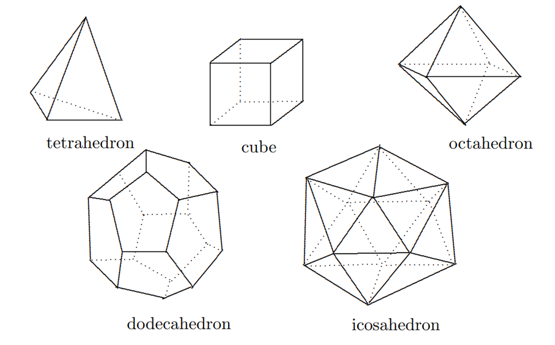
Polyhedra
A polyhedron is a 3-dimensional object bounded by polygonal plan surfaces called faces.

Slide 11

Polyhedra
A polyhedron is a 3-dimensional object bounded by polygonal plan surfaces called faces.
The Euler Polyhedral Formula: If a polyhedron has $V$ vertices, $E$ edges and $F$ faces, then $V−E+F=2$. (Notice similarity to Euler Identity [Theorem 10.1])

Slide 12

Polyhedra
A polyhedron is a 3-dimensional object bounded by polygonal plan surfaces called faces.
The Euler Polyhedral Formula: If a polyhedron has $V$ vertices, $E$ edges and $F$ faces, then $V−E+F=2$. (Notice similarity to Euler Identity [Theorem 10.1])
Any polyhedron can be drawn as a planar graph.

Slide 13
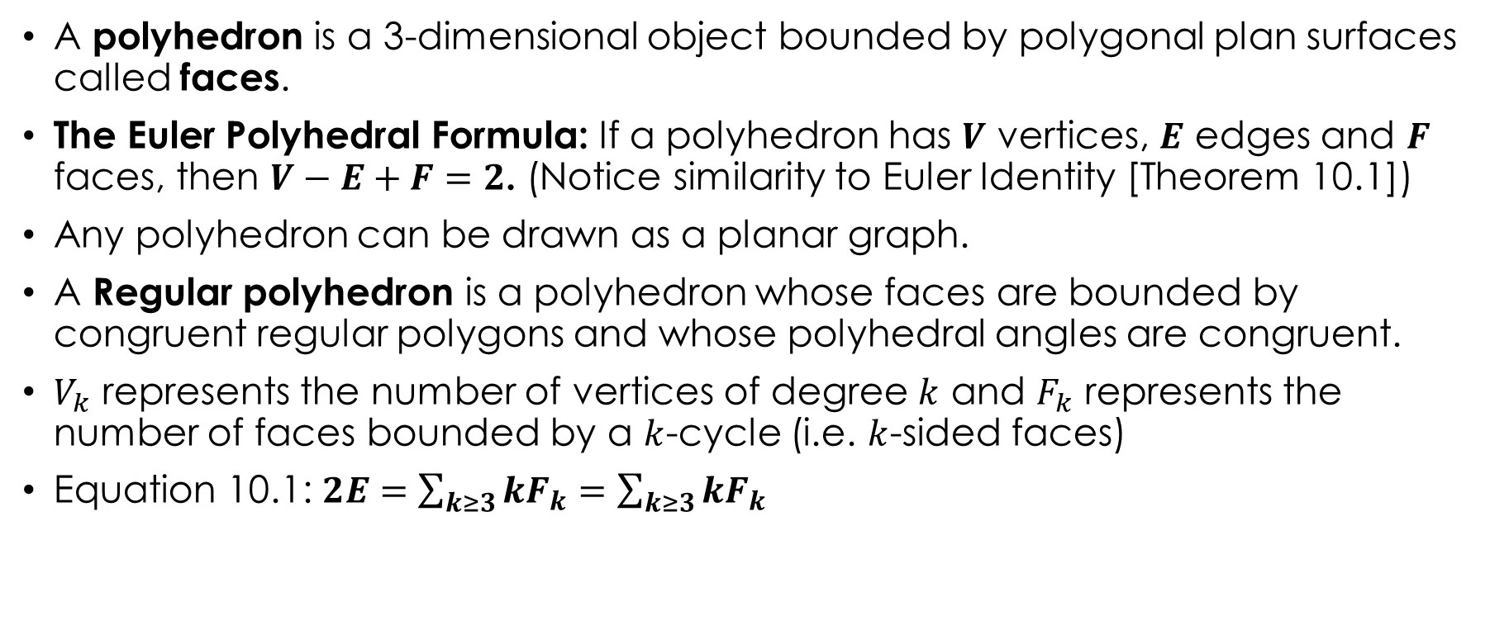
Polyhedra
A polyhedron is a 3-dimensional object bounded by polygonal plan surfaces called faces.
The Euler Polyhedral Formula: If a polyhedron has $V$ vertices, $E$ edges and $F$ faces, then $V−E+F=2$. (Notice similarity to Euler Identity [Theorem 10.1])
Any polyhedron can be drawn as a planar graph.
A Regular polyhedron is a polyhedron whose faces are bounded by congruent regular polygons and whose polyhedral angles are congruent.
$V_{k}$ represents the number of vertices of degree $k$ and $F_{k}$ represents the number of faces bounded by a $k$-cycle (i.e. $k$-sided faces)
Equation 10.1: $2E=\sum_{k≥3}{kF_{k}}=\sum_{k≥3}{kF_{k}}$

Slide 14
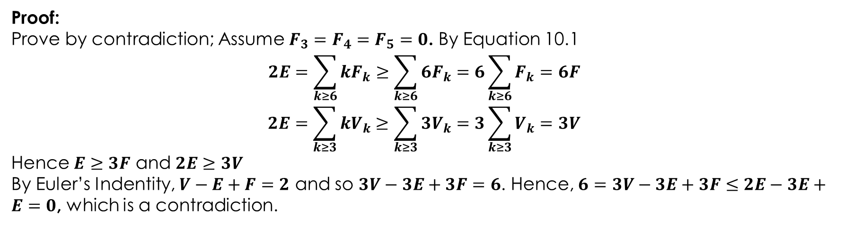
Theorem 10.6
Theorem 10.6
At least one face of every polyhedron is bounded by a k-cycle for some $k$ where $k∈\{3,4,5\}$
Proof:
Prove by contradiction; Assume $F_{3}=F_{4}=F_{5}=0$. By Equation 10.1
$$2E=\sum_{k≥6}{kF_{k}}≥\sum_{k≥6}{6F_{k}}=6\sum_{k≥6}{F_{k}}=6F$$
$$2E=\sum_{k≥3}{kV_{k}}≥\sum_{k≥3}{3V_{k}}=3\sum_{k≥3}{V_{k}}=3V$$
Hence $E≥3F$ and $2E≥3V$
By Euler’s Indentity, $V−E+F=2$ and so $3V−3E+3F=6$. Hence, $6=3V−3E+3F≤2E−3E+E=0$, which is a contradiction.

Slide 15

The Five Regular Polyhedra
Proof that these are the only five in Theorem 10.7

Slide 16
K₅ and K_{3,3}
The Book also proves that the graphs K₅ and K_{3,3} are nonplanar in corollaries 10.8,9.
K₅
K_{3,3}

Slide 17
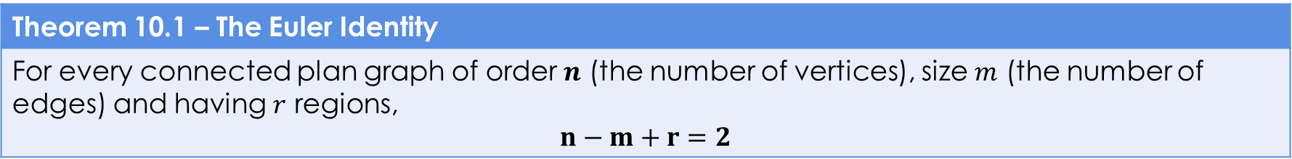
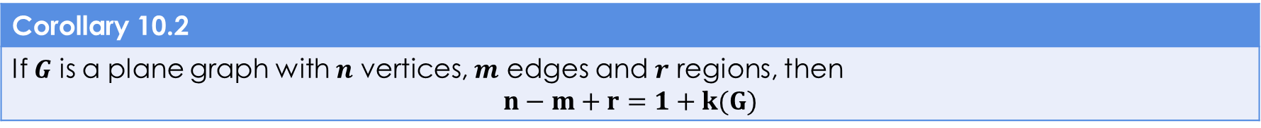
Theorems and Equations
The Euler Polyhedral Formula
If a polyhedron has $V$ vertices, $E$ edges and $F$ faces, then $$V−E+F=2$$
Theorem 10.1 – The Euler Identity
For every connected plan graph of order $n$ (the number of vertices), size $m$ (the number of edges) and having $r$ regions, $$n−m+r=2$$
Corollary 10.2
If $G$ is a plane graph with $n$ vertices, $m$ edges and $r$ regions, then $$n−m+r=1+k(G)$$
Theorem 10.3
If $G$ is a planar graph of order $n≥3$ and size $m$, then $$m≤3n−6$$

Slide 18
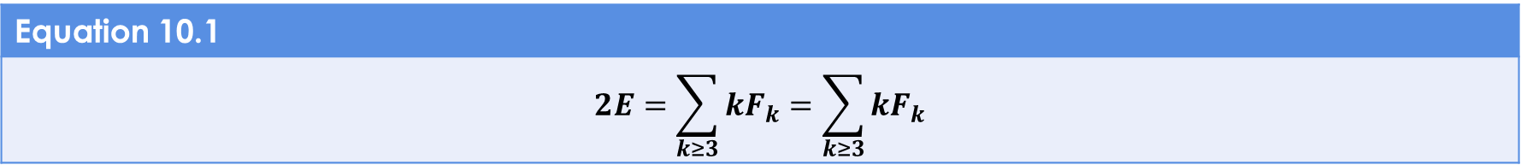
Theorems and Equations (CONT.)
Theorem 10.4
If $G$ is a planar graph of order $n≥5$ and size $m$ such that $m>3n−6$, then $G$ is nonplanar
Corollary 10.5
Every planar graph contains a vertex of degree 5 or less
Equation 10.1
$$2E=\sum_{k≥3}{kF_{k}}=\sum_{k≥3}{kF_{k}}$$
Theorem 10.6
At least one face of every polyhedron is bounded by a k-cycle for some $k$ where $k∈\{3,4,5\}$
Theorem 10.7
There are exactly five regular polyhedra

Slide 19
Theorems and Equations (CONT.)
Corollary 10.8
The graph K₅ is nonplanar
Corollary 10.9
The graph K_{3,3} is nonplanar

